Slide 1
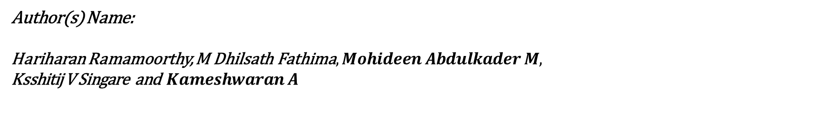
VIMALA: Vision-based Interpretation and Modelling using AquaSpatioTemporalNet for Land and Aquatic Systems
Author(s) Name:
Hariharan Ramamoorthy, $\text{M} \text{Dhilsath} \text{Fathima}, Mohideen Abdulkader M,$ Ksshitij V Singare and $Kameshwaran A$
Presented By: Ksshitij V Singare

Slide 2
Aim of the Proposed Work
The objective is to enhance the accuracy of monitoring and predicting water body changes in Gujarat despite challenges such as seasonal variations and human-induced impacts.
The AquaSpatioTemporalNet model combines CNN, LSTM, and Transformer architectures, utilizing Sentinel-2 and S-2 Harmonized satellite data.
This approach achieves high precision (95%) and recall (93.1%) with a reduced MSE of 0.0024, enabling accurate water body monitoring and supporting decision-making in water resource management.
The model facilitates effective environmental planning, flood risk management, and sustainable water usage by providing precise forecasting and real-time insights.

Slide 3
Research Motivation
Gujarat faces critical water scarcity, with increasing threats from climate change, urbanization, and overexploitation of water resources.
Seasonal monsoon variations significantly alter water body extents, complicating consistent monitoring efforts.
Traditional water monitoring methods are labor-intensive, limited in scope, and fail to capture dynamic water body changes over time.
Accurate, real-time monitoring is essential for managing water resources, mitigating flood risks, and addressing long-term environmental sustainability.

Slide 4
Limitations of the Existing Land Cover and Land Use Classifiers
Study | Methods | Advantages | Limitations
McFeeters (1996) | Normalized Difference Water Index (NDWI) | Simple and effective for water body detection using green and NIR bands. | May misclassify water in urban areas due to reflectance from structures and vegetation.
Xu (2006) | Modified NDWI (MNDWI) | Improved accuracy in urban areas by replacing NIR with SWIR band. | Limited performance in distinguishing water from some urban surfaces and wetlands.
Rokni et al. (2014) | NDWI and MNDWI with multitemporal Landsat imagery | Captures seasonal variations in water bodies effectively. | Requires extensive preprocessing for multitemporal analysis; computationally intensive.
Belgiu & Drăguţ (2016) | Random Forest (RF) for LULC classification | High accuracy and robustness for land use/land cover classification. | Relies on consistent input data; lacks temporal analysis capability.
Zhou et al. (2018) | U-Net++ | Effective for handling complex remote sensing tasks, including water body detection. | Limited temporal analysis capability; high computational costs for training.

Slide 5
Limitations of the Existing Land Cover and Land Use Classifiers
Study | Methods | Advantages | Limitations
Khurana & Saxena (2020) | Extreme Learning Machines (ELMs) | Efficient for change detection across multitemporal satellite imagery. | Less accurate in handling long-term temporal dependencies; lacks spatial feature extraction.
Zhang et al. (2021) | CNN and LSTM hybrid model | Combines spatial and temporal analysis for improved water body change prediction. | Limited ability to handle long-range temporal dependencies.
Wang et al. (2024) | Transformer-based remote sensing model | Utilizes attention mechanisms to capture long-term water body dynamics effectively. | High computational requirements; needs further optimization for specific regional challenges.
Scheibel et al. (2024) | Hydro-Physical Indices and Anthropogenic Effect Analysis | Characterizes water bodies under human and environmental impact conditions. | Lacks predictive capability for future water body dynamics.
Cao et al. (2024) | Enhanced U-Net with Multiscale Information Fusion | Effective for high-resolution water body extraction. | Requires extensive training data; computationally expensive for large-scale analysis.

Slide 6
Contribution of Proposed Research
Enhanced Prediction Accuracy: The AquaSpatioTemporalNet model achieves superior performance, demonstrating significantly higher precision, recall, and reduced error compared to traditional and other deep learning models for water body detection.
Hybrid Architecture Integration: Combines CNN for spatial analysis, LSTM for capturing temporal trends, and Transformer for long-range dependency modelling, enabling comprehensive analysis of water body dynamics.
Advanced Temporal Dynamics: The model effectively captures seasonal variations and long-term changes in water bodies, providing actionable insights for water resource management.
Data-Driven Insights: Utilizes Sentinel-2 and S-2 Harmonized satellite data, incorporating NDWI and NDVI indices to enhance differentiation between water and vegetation.
Scalable Solution: Provides a robust framework applicable to large-scale environmental monitoring in other geographic regions facing similar challenges.
Improved Feature Representation: Integrates spatial and temporal features with attention mechanisms for precise forecasting, addressing limitations in existing models.

Slide 7
Proposed work
A hybrid deep learning architecture
Combines Convolutional Neural Networks (CNNs) for spatial feature extraction
Long Short-Term Memory (LSTM) networks for capturing temporal variations
Transformer networks to handle long-range dependencies in time-series data for monitoring and forecasting changes in water bodies.

Slide 8
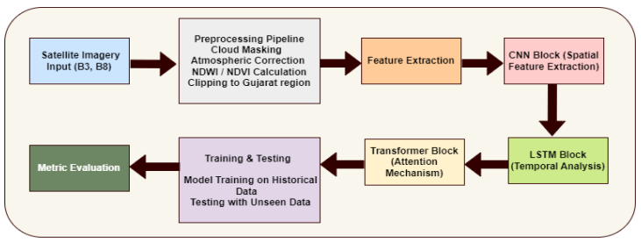
Architecture Diagram for VIMALA

Slide 9
Data Acquisition
Satellite imagery is collected from Sentinel-2 and S-2 Harmonized datasets, which provide high-resolution multispectral images of water bodies.
The data spans several years to capture both seasonal and long-term changes in water bodies.
Satellite Imagery Input (B3, B8)
Band 3 (Green): Sensitive to vegetation and water reflectance.
Band 8 (Near Infrared): Highlights water body boundaries and vegetation health.

Slide 10
Data Preprocessing:
Cloud Masking: Removes cloud artifacts for clear visibility.
Using the Sentinel-2 QA60 band, only images with less than 10% cloud cover are retained, ensuring dataset accuracy.
Clipping: Restricts data to the Gujarat region for focused analysis.
the satellite imagery is spatially clipped to the geographical boundaries of the state. This reduces computational overhead and ensures that the analysis is region-specific.
Atmospheric Correction: Adjusts for atmospheric effects on spectral data.
NDWI/NDVI Calculation: NDWI (Normalized Difference Water Index) for water detection.
NDVI (Normalized Difference Vegetation Index) to isolate vegetation areas.

Slide 11
CNN Block (Spatial Feature Extraction)
To extract spatial features such as shapes, boundaries, and sizes of water bodies from satellite imagery.
CNN (Convolutional Neural Network) layers analyze pixel-based spatial patterns, enabling the model to recognize key features like edges, textures, and shapes in satellite images.
For water body detection, the CNN block identifies water pixels by distinguishing them from vegetation, urban areas, and barren land.
Convolutional Layers:
Detect spatial patterns using convolution filters (kernels).
Filters are optimized during training to emphasize features relevant to water bodies.
Pooling Layer:
Downsample the feature maps to reduce computational complexity while preserving essential spatial information.
Pooling layer (typically max-pooling) reduces the spatial dimensions by selecting the maximum value within a sliding window.

Slide 12
LSTM Block (Temporal Analysis)
To analyze temporal changes in water bodies over time by learning long-term dependencies in sequential data.
LSTM (Long Short-Term Memory) networks are designed to handle sequential data and remember long-term dependencies while addressing the vanishing gradient problem.
For AquaSpatioTemporalNet, LSTM captures temporal dynamics such as seasonal fluctuations, water expansion, or contraction due to climatic events.
The LSTM takes the CNN-extracted spatial features as input. These features are treated as a sequence, where each time step corresponds to a snapshot (year or month) of the water body data.
Flow of Information in the LSTM Block:
Input:
Sequential data derived from spatial feature maps processed by the CNN block.
Temporal Learning:
Processes changes in water body shapes, boundaries, and extents across time steps.
Output:
Temporal features (e.g., rate of expansion/contraction, seasonal variations) passed to the Transformer block for attention-based refinement.

Slide 13
Transformer Block (Attention Mechanism)
To enhance the AquaSpatioTemporalNet's ability to focus on the most relevant time steps in the sequence and refine temporal feature representation for accurate prediction of long-term water body dynamics.
Overview of the Transformer Block:
Purpose of Transformers:
Introduced as a mechanism to process sequential data while overcoming the limitations of recurrent models like LSTMs.
Uses attention mechanisms to prioritize the most critical time steps in the input sequence.
Capable of modeling long-range dependencies effectively, making it suitable for temporal analysis in water body prediction.
Attention Mechanism:
Self-Attention:
Computes the relationships between all time steps in the sequence.
Focuses on significant time steps (e.g., monsoon onset or sudden changes in water body extents).

Slide 14
Training & Testing ,Metric Evaluation
Training & Testing
Train the model on historical data and evaluate its performance on unseen data.
Uses historical water body data for model learning.
Evaluates generalization capability on new, unseen satellite imagery.
Metric Evaluations
Assess the model’s performance using quantitative metrics.
Precision and Recall: Measures the accuracy of water body detection.\
MSE (Mean Squared Error): Evaluates the prediction error.
R² (Coefficient of Determination): Indicates model fit.

Slide 15
Experimental Result and Analysis

Slide 16
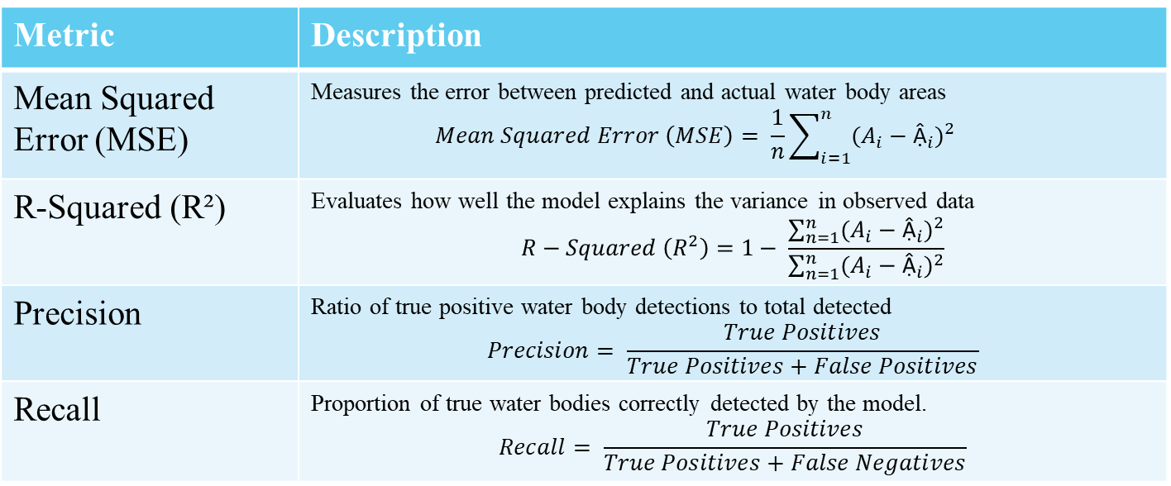
Metrics Evaluated for Proposed Work
Metric | Description
Mean Squared Error (MSE) | Measures the error between predicted and actual water body areas $$Mean Squared Error \left(MSE\right)= \frac{1}{n}\sum_{i=1}^{n}{{(A_{i}−{\text{Ậ}}_{i})}^{2}}$$
R-Squared (R²) | Evaluates how well the model explains the variance in observed data $$R−Squared \left(R^{2}\right)=1− \frac{\sum_{n=1}^{n}{{(A_{i}−{\text{Ậ}}_{i})}^{2}}}{\sum_{n=1}^{n}{{(A_{i}−{\text{Ậ}}_{i})}^{2}}}$$
Precision | Ratio of true positive water body detections to total detected $$Precision= \frac{True Positives}{True Positives+False Positives}$$
Recall | Proportion of true water bodies correctly detected by the model. $$Recall= \frac{True Positives}{True Positives+False Negatives}$$

Slide 17
Model Performance
The proposed AquaSpatioTemporalNet was trained and evaluated on the preprocessed satellite imagery data using NDWI and NDVI indices to detect and predict water body extents. Performance metrics such as Precision, Recall, MSE, and R² were used to assess the model’s accuracy and prediction quality.
Model | Precision | Recall | MSE | R²
CNN-based | 87.2 | 85.4 | 0.0046 | 0.81
U-Net++ | 89.8 | 87.3 | 0.0039 | 0.84
CNN-LSTM | 91.8 | 89.7 | 0.0034 | 0.87
CNN-Transformer | 93.2 | 90.6 | 0.0030 | 0.89
Proposed AquaSpatioTemporalNet | 95.0 | 93.1 | 0.0024 | 0.93

Slide 18
Discussion of Results
Hybrid Spatial and Temporal Feature Extraction: Combines CNN, LSTM, and Transformer blocks to capture both spatial features (water body shapes, boundaries, sizes) and temporal dynamics (long-term changes, seasonal variations).
Attention Mechanism for Long-Term Dependencies: Transformer blocks enable the model to focus on relevant time steps, enhancing predictions of long-term
Improved Feature Representation: High-resolution spatial features captured by CNN are effectively passed to LSTM and Transformer layers, ensuring accurate modeling of temporal dependencies and reducing prediction errors. Dynamics such as seasonal fluctuations or gradual changes.
Superior Performance: AquaSpatioTemporalNet surpasses traditional and advanced methods (e.g., CNN, U-Net++) by integrating spatial and temporal information within a unified framework.

Slide 19
Conclusion
The AquaSpatioTemporalNet model integrates CNN, LSTM, and Transformer components to capture both spatial and temporal dynamics effectively.
Outperformed traditional and advanced deep learning models in metrics like precision, recall, MSE, and R².
Achieved superior results with high precision and recall, low MSE, and strong R², making it highly effective for water body monitoring and forecasting.
The attention mechanism allows accurate predictions of long-term water body changes.
Demonstrates potential as a reliable tool for real-time monitoring and decision-making in water resource management.

Slide 20
Future Work
Integrate multi-source data, such as SAR, to enhance detection in cloudy environments.
Incorporate climate variables to improve long-term water body predictions.
Explore optimization techniques, like model pruning or lightweight architectures, to increase computational efficiency for real-time applications.
Investigate advanced temporal models (e.g., GNNs, TCNs) for improved temporal dependency modeling.
Apply Explainable AI (XAI) techniques to enhance model interpretability and transparency for broader environmental monitoring applications.

Slide 21
References
McFeeters, S. K. (1996). The use of the normalized difference water index (NDWI) in the delineation of open water features. International Journal of Remote Sensing, 17(7), 1425- 1432.
. Xu, H. (2006). Modification of normalized difference water index (NDWI) to enhance open water features in remotely sensed imagery. International Journal of Remote Sensing, 27(14), 3025-3033.
Rokni, K., Ahmad, A., Selamat, A., & Hazini, S. (2014). Water feature extraction and change detection using multitemporal Landsat imagery. Remote Sensing, 6(5), 4173-4189.
Pal, M., & Mather, P. M. (2003). An assessment of the effectiveness of decision tree methods for land cover classification. Remote Sensing of Environment, 86(4), 554-565.
Belgiu, M., & Drăguţ, L. (2016). Random forest in remote sensing: A review of applications and future directions. ISPRS Journal of Photogrammetry and Remote Sensing, 114, 24-31.
Lichao Mou ,Pedram Ghamisi and Xiao Xiang Zhu Deep Recurrent Neural Networks for Hyperspectral Image Classification ,IEEE TRANSACTIONS ON GEOSCIENCE AND REMOTE SENSING, VOL. 55, NO. 7, JULY 2017
Zhou, Z., Rahman Siddiquee, M. M., Tajbakhsh, N., & Liang, J. (2018). Unet++: A nested u-net architecture for medical image segmentation. Deep Learning in Medical Image Analysis, 3, 6-9.

Slide 22
M. Khurana and V. Saxena, "A Unified Approach to Change Detection Using an Adaptive Ensemble of Extreme Learning Machines," in IEEE Geoscience and Remote Sensing Letters, vol. 17, no. 5, pp. 794-798, May 2020 .
Zhang, X., Zhou, Y., & Luo, J. (2021). Deep learning for processing and analysis of remote sensing big data: a technical review. Big Earth Data, 6(4), 527–560.
Wang, R.; Ma, L.; He, G.; Johnson, B.A.; Yan, Z.; Chang, M.; Liang, Y. Transformers for Remote Sensing: A Systematic Review and Analysis. Sensors 2024, 24, 3495.
Ogilvie, A.; Poussin, J.-C.; Bader, J.-C.; Bayo, F.; Bodian, A.; D.; Sambou, S. Combining Multi-Sensor Satellite Imagery to Improve Long-Term Monitoring of Temporary Surface Water Bodies in the Senegal River Floodplain. Remote Sens. 2020, 12, 3157.
Scheibel, C.H.; Nascimento, A.B.d.; Júnior, G.d.N.A.; Almeida, A.C.d.S.; Silva, T.G.F.d.; Silva, J.L.P.d.; Junior, F.B.d.S.; Farias, J.A.d.; Santos, J.P.A.d.S.; Oliveira-Júnior, J.F.d.; et al. Characterization of Water Bodies through Hydro-Physical Indices and Anthropogenic Effects in the Eastern Northeast of Brazil. Climate 2024, 12, 150.
Cao H, Tian Y, Liu Y, Wang R. Water body extraction from high spatial resolution remote sensing images based on enhanced U-Net and multi-scale information fusion. Sci Rep. 2024 Jul 12;14(1):16132.
H. Ramamoorthy, M. Ramasundaram, R. S. P. Raj "TransAttU-Net Deep Neural Network for Brain Tumor Segmentation in Magnetic Resonance Imaging," in IEEE Canadian Journal of Electrical and Computer Engineering, vol. 46, no. 4, pp. 298-309, Fall 2023.
Dhilsath Fathima, M., Hariharan, R., Shome, S., Kharsyiemlieh, M., Deepa, J., Jayanthi, K. (2024). Sign Language Interpreter Using Stacked LSTM-GRU. In: Sharma, H., Chakravorty, A., Hussain, S., Kumari, R. (eds) Artificial Intelligence: Theory and Applications. AITA 2023. Lecture Notes in Networks and Systems, vol 844. Springer, Singapore.

Slide 23
Thank You

